Slide 1
Hotel concepts, brilliant User meeting 28 March 2012, houten nl
Nick Price

Slide 2
agenda
2000 – 2010 – Review
2010 – 2020 – Opportunities
distribution
in-room infotainment
mobile
cloud

Slide 3
2000-2010
incremental or dramatic change?

Slide 4
IP & internet
application integration at low cost
internet as a product
distribution opportunity or threat?
indispensable asset, yet to be monetised
Notes:
IP and Internet
Fundamental standardized network protocol allowing for non-proprietary communication between devices and applications paving the way for integration of those applications at low cost
We were slow to the Internet party. In 2000 for the most part we were barely beginning to Google our guests, but our guests were already Googling us.

Slide 5
HSIA usage
source: Mandarin Oriental

Slide 6
HSIA device usage
10
8
6
4
2
source: Mandarin Oriental

Slide 7
internet distribution
Billion Euros p.a.
Source: Carl H Marcussen, Centre for Regional and Tourism Research

Slide 8
internet distribution
source: Carl H Marcussen, Centre for Regional and Tourism Research

Slide 9
internet distribution
source: Mandarin Oriental

Slide 10
tv infotainment
source: Mandarin Oriental
Notes:
In-Room Technology
TV's - from thick to thin
Decline of VoD (Adult) revenue models
Decline of VoD (Blockbuster) revenue models

Slide 11
telephony
(the great tech FAIL)
US$
700,000
600,000
500,000
400,000
300,000
200,000
100,000
source: Mandarin Oriental
Notes:
Telephony the great hotel tech FAIL.
Failure to move with the technology
Greed - from everyone
Unwilling to understand the needs of the customer
The customer moved on and left us behind
We are left with a legacy cost of PSTN capable PABX's installed in our hotels
Time to think cloud/hosted PABX?
Add second axis for PABX costs

Slide 12
DIY application development
few if any examples of success
most are now regarded as legacy applications
most are US-centric
none are positioned for global deployment
Notes:
Realization now that DIY application development is not optimal

Slide 13
application software
Appication Suites
rise and fall of application suites
applications, lots of them
what happened to ASP?
INV
Accounts
Rev Mgt
PMS
S & C
POS
Accounts

Slide 14
networks everywhere
Reservations
HVAC
Internet
Phone
Rm 108
TV
Door Lock
Audio
Lighting
Front Desk
Rm 118
Rm 178
Network
365 / 7 / 24
Rm 128
Rm 168
Rm 138
Rm 158
Rm 148

Slide 15
hotel global networks
BEIJING
HONG KONG
Hotel Data Centre
GENEVA
PARIS
LAS
VEGAS
NEW
YORK

Slide 16
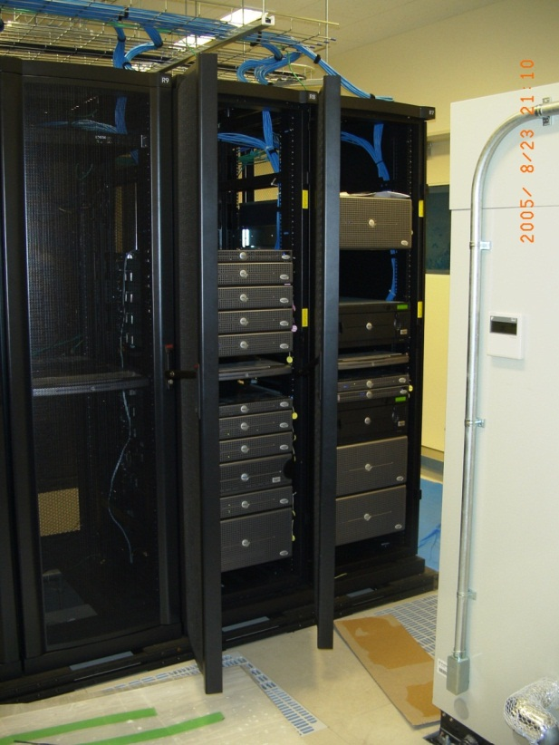
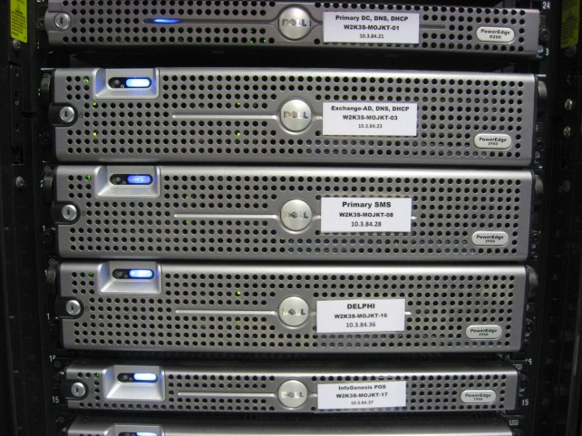
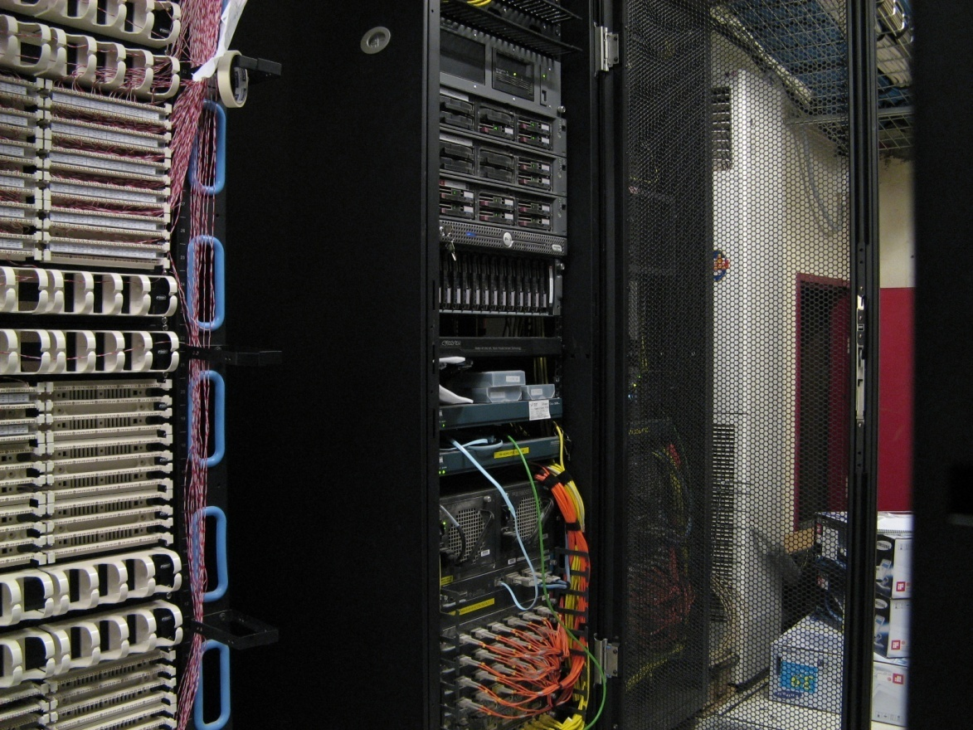
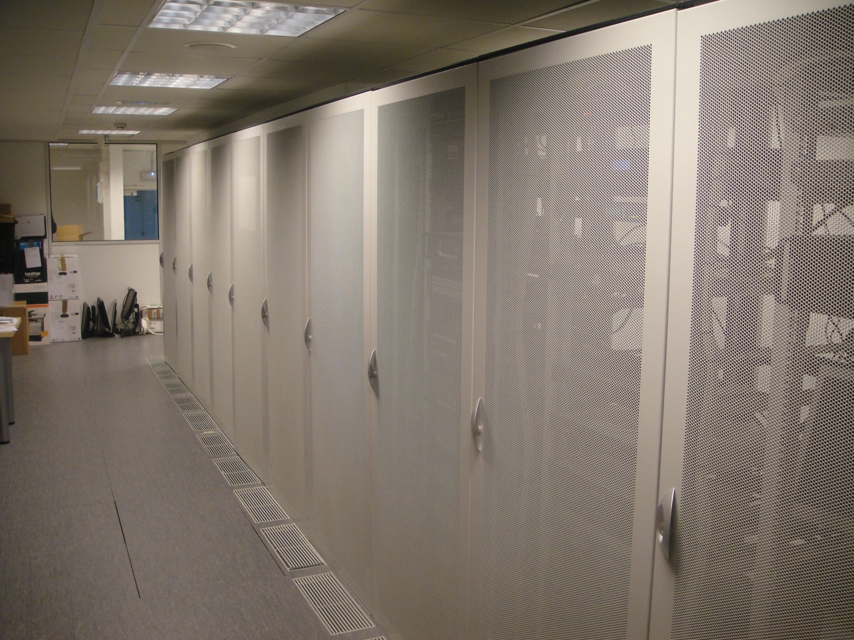
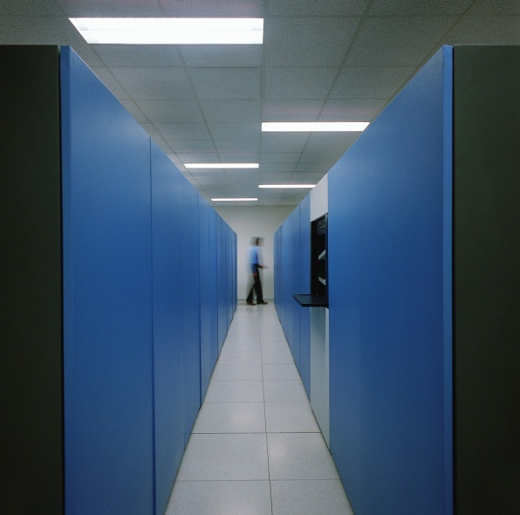
from under the stairs to a modern hotel data center

Slide 17
on property skills gap
smart room
VOIP
IRES
complexity
skills gap
HSIA
CRES
PMS
# of technical staff
year

Slide 18
challenges of data privacy & security
never a consideration in the age of brass keys and CRT’s
PCI born in 2004, same year as Facebook
Notes:
Challenges of Data Privacy and Security
Never a consideration in the age of brass keys , CRT's and Coax.
Many PCI guidelines focus on physical security that has little to do with networks and which could/should have been visible to us as a problem years before.
PCI compliance as a concept was born in 2004, the same year that Facebook was founded. Both of them owe their notoriety to the Internet.

Slide 19
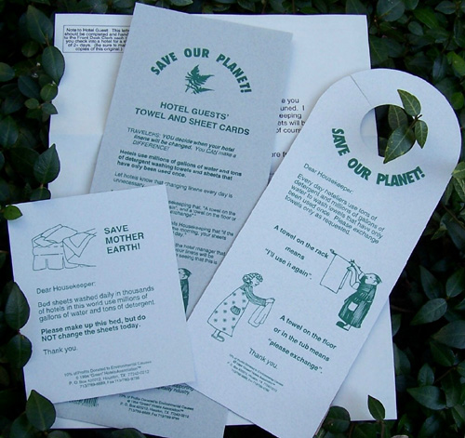
green initiatives
Notes:
First green initiatives - energy saving, mostly marketing led

Slide 20
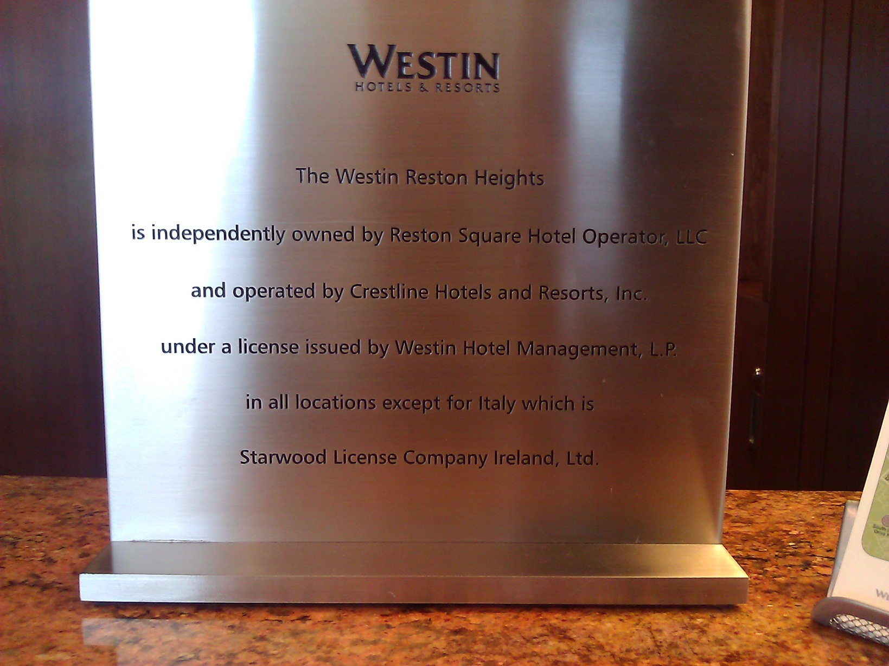
asset-lite business models

Slide 21
international chain expansion

Slide 22
2010-2020
change is here

Slide 23
agenda
2000 – 2010 – Review
2010 – 2020 – Opportunities
distribution
in-room infotainment
cloud

Slide 24
distribution

Slide 25
How can I help?

Slide 26
Hotel
1990
CRS
Hotel
Hotel
Hotel
Hotel
CRS
Hotel
Hotel
travel
agent
Hotel
customer
GDS
Hotel
Hotel
CRS
Hotel
Hotel
Hotel
Hotel
CRS
Hotel
Hotel

Slide 27
Entertainment
F & B
Golf
Hotel room
Transport
Meeting / conference
poor representation of product to customer
GDS Green Screen
ADS selling unapproved inventory
loss of price/rate integrity
customer information unavailable to 3rd parties (travel agent/representation company)
poor representation of customer to hotel
GDS PNR difficult to link to guest database
reduced ability to cross/up sell
contributes to low repeat guest ratio

Slide 28
2000’s
Hotel
Hotel
brand.com
CRS
Hotel
Hotel
Hotel
customer
GDS
CRS
Hotel
Hotel
Hotel
Hotel
OTA
CRS
Hotel
Hotel
Hotel

Slide 29
2000’s
Hotel
Hotel
brand.com
CRS
Hotel
Hotel
Hotel
customer
GDS
CRS
Hotel
Hotel
Hotel
Hotel
OTA
CRS
Hotel
Hotel
Hotel

Slide 30
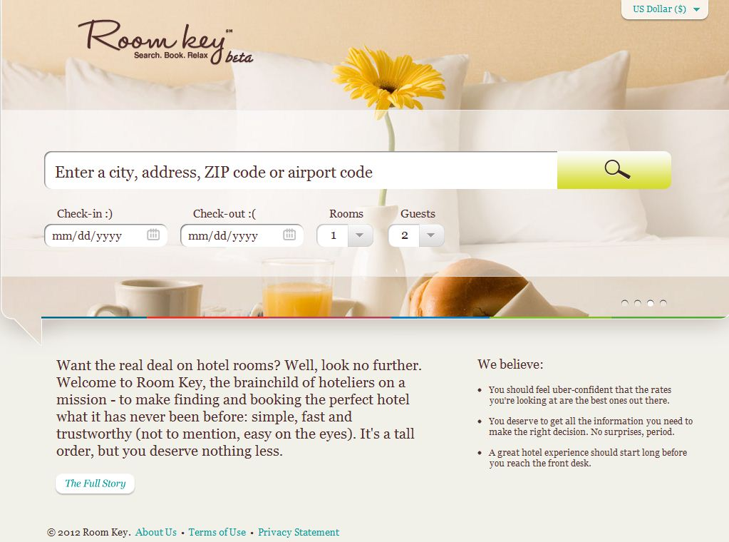
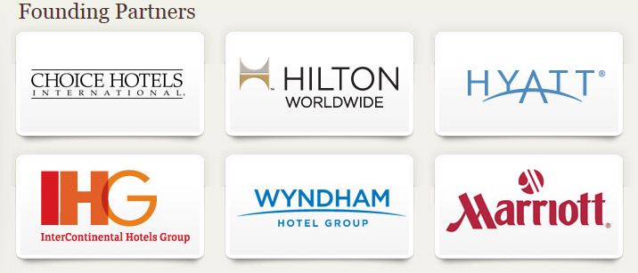

Slide 31
distribution
10 years fighting the wrong enemy
enemies are not the OTA’s
Expedia
booking.com
Travelocity etc.
(fr)enemies are:
Google - mapping and search excellence
Microsoft - global presence and cloud
Facebook - 800m users
Apple - 30% iTunes commissions
Amazon - Internet merchandising and pricing

Slide 32
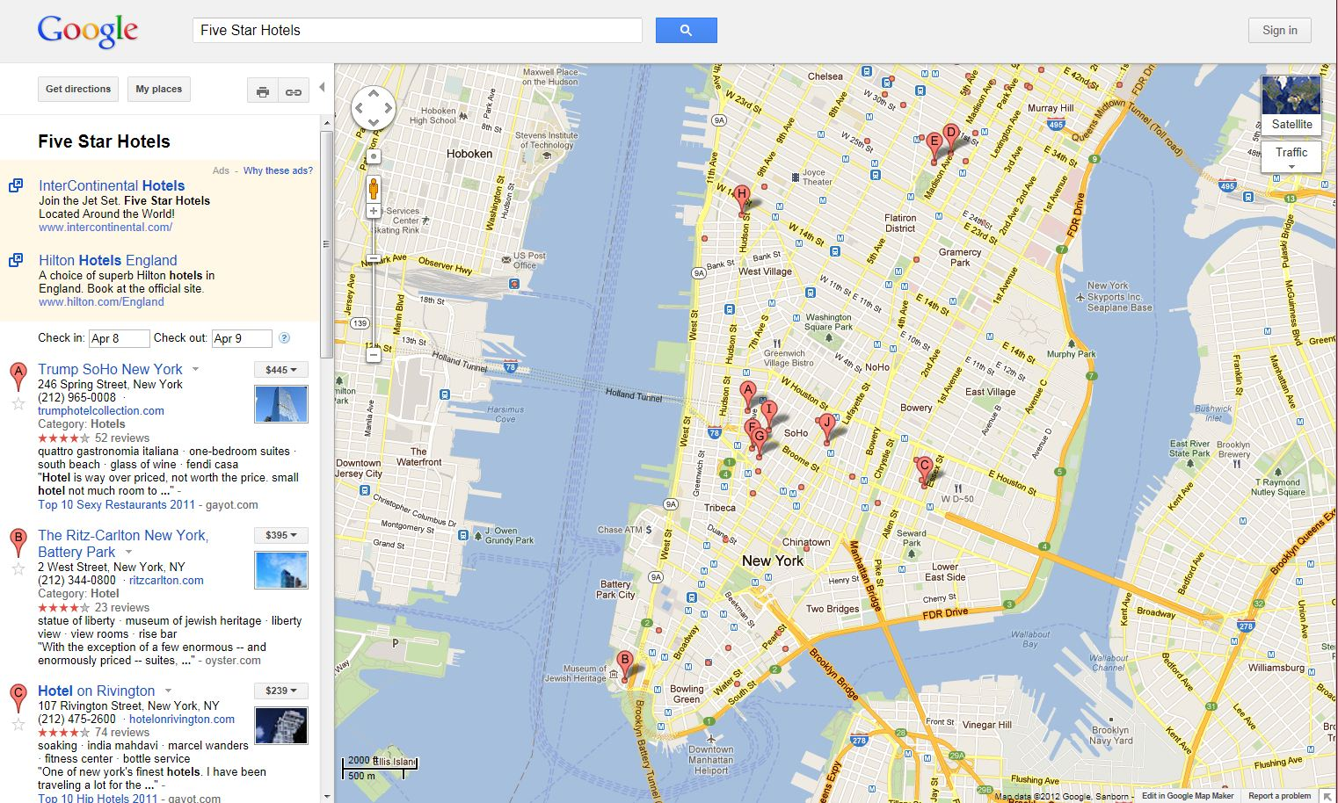

Slide 33
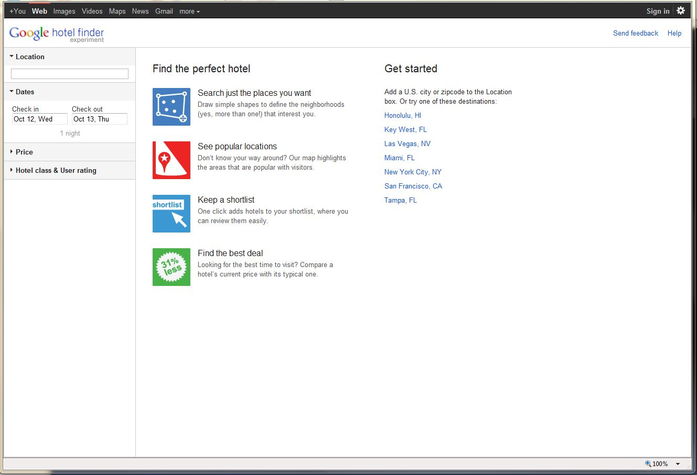

Slide 34
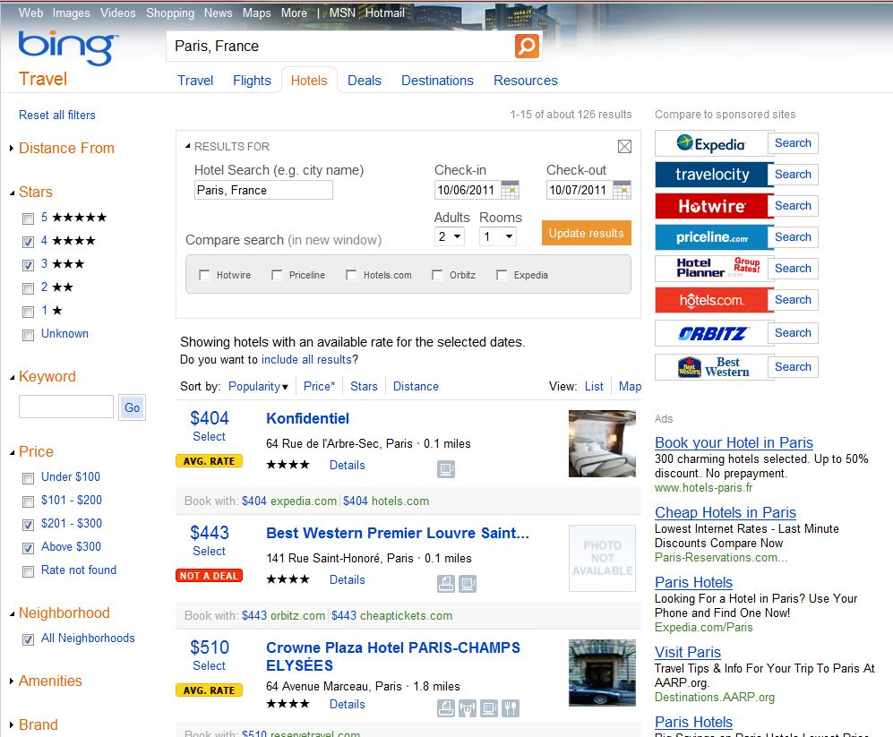

Slide 35
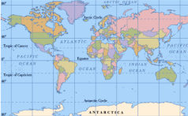
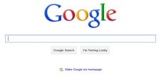
2015
Facebook
800m+ users
customer
knowledge
$20 Billion +
$10 Billion
fulfilment
CRS
$50+Million
$50+ Million
$10 Billion
iTunes
AppStore
$20 Billion +

Slide 36
in-room infotainment

Slide 37
VoD utilisation 2006 - 2020

Slide 38
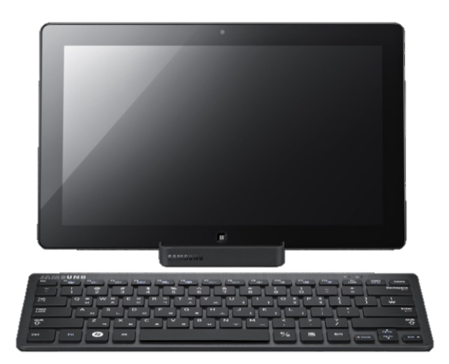
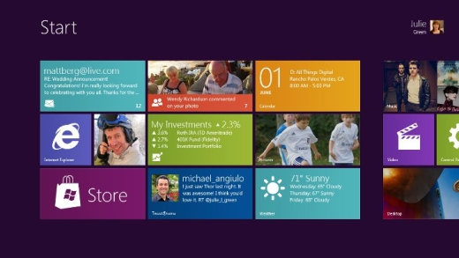
leading hotel companies will build hotel rooms without TV’s within 5 years

Slide 39
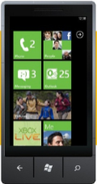
21st century in-room entertainment
)
)
)
)
)
)
)
)
)
)
)
)
Wi-Fi
Stored
Content
On
Mobile

Slide 40
21st century in-room entertainment
)
)
)
)
)
)
)
)
)
)
)
NetFlix
Hulu
YouTube
)
)
)
)
)
)
)
Wi-Fi
Stored
Content
On
Mobile

Slide 41
$100 minimum wage forces labour efficiencies
EXCO: 8
Department Head: 20
Supervisor: 16
General Staff: 717
Notes:
1) Minimum wage - $100 an hour
a) Labour efficiencies crucial to business survival
b) Location, tracking, messaging

Slide 42
cloud

Slide 43
CAPEX
VS
OPEX
ecosystems
explosion of technology
by 2015 75% of successful hotel companies will have migrated core systems to “the cloud”
deployment velocity
emerging markets
opportunity
global reach
http://hospitalitytechnology.edgl.com/top-stories/Are-We-in-the-Cloud-Decade-66712
Notes:
1) Migration to the Cloud
a) Explosion of technology
b) Emerging markets and legacy technologies
c) CAPEX vs. OPEX
d) Future architectures
e) Ecosystems

Slide 44
cloud rationale
global reach
velocity to new markets (asia/e-eu)
agility
capex -> opex
pci compliance / security
addresses property skills gap

Slide 45
application software
Appication Suites
rise and fall of application suites
applications, lots of them
what happened to ASP?
INV
Accounts
Rev Mgt
PMS
S & C
POS
Accounts

Slide 46
cloud fragmentation danger
Amazon
Réservations
SalesForce
“ How do I integrate my systems now? “
Sales
Phone
Catering
HOTEL
Door Lock
Google
RackSpace
HVAC
Accounts
PMS
Azure
POS

Slide 47
WANTED TO BUY: cloud ecosystem
“ the battle of devices has now become a war of ecosystems, where ecosystems include not only the hardware and software of the device, but developers, applications, ecommerce, advertising, search, social applications, location-based services, unified communications and many other things. Our competitors aren’t taking our market share with devices; they are taking our market share with an entire ecosystem. This means we’re going to have to decide how we either build, catalyse or join an ecosystem “
Stephen Elop CEO Nokia (feb 04 2011)
Notes:
The power of ecosystems - largest ISV is the Next Generation Hospitality Federation
We are seeing this war play out in mobile now
ELOP (Nokia)
"The battle of devices has now become a war of ecosystems, where ecosystems include not only the hardware and software of the device, but developers, applications, ecommerce, advertising, search, social applications, location-based services, unified communications and many other things. Our competitors aren’t taking our market share with devices; they are taking our market share with an entire ecosystem. This means we’re going to have to decide how we either build, catalyse or join an ecosystem"
If we ignore this need, the world will move on and move past us. Our industry will find its own new solutions and they will not be the ones we are familiar with today
Ever heard of these PMS'?
西软 (Foxhis)
中软,( Cshis under Ctrip )
AG NEHOPS (NEC)

Slide 48
Azure hospitality services ecosystem
PMS
SALES
ACCOUNTS
…………
hospitality services layer
payment
distribution
identity / SSO
hotel media vault
others
service bus
access control
caching
geo-replication / CDN
north
USA
south
USA
north
EMEA
south EMEA
south east
ASIA
east
ASIA

Slide 49
hotel companies are architecturally complex and need quality solutions
globally available
365/7/24 availability
hosted by trusted partners Microsoft / Google
opex acquisition model
Office 365 or Google Apps migration is a good first step towards an ‘above property’ cloud future

Slide 50
thank you
Nick Price
 nickprice@netsystechnology.com

